Slide 1

Improving Road Awareness with a Real-Time Co-Pilot by Harnessing the Power of Dashcams
Adrian John
CSC 752 - Computer Vision
Supervised by: Dr. Lina Chato
8th December 2024

Slide 2
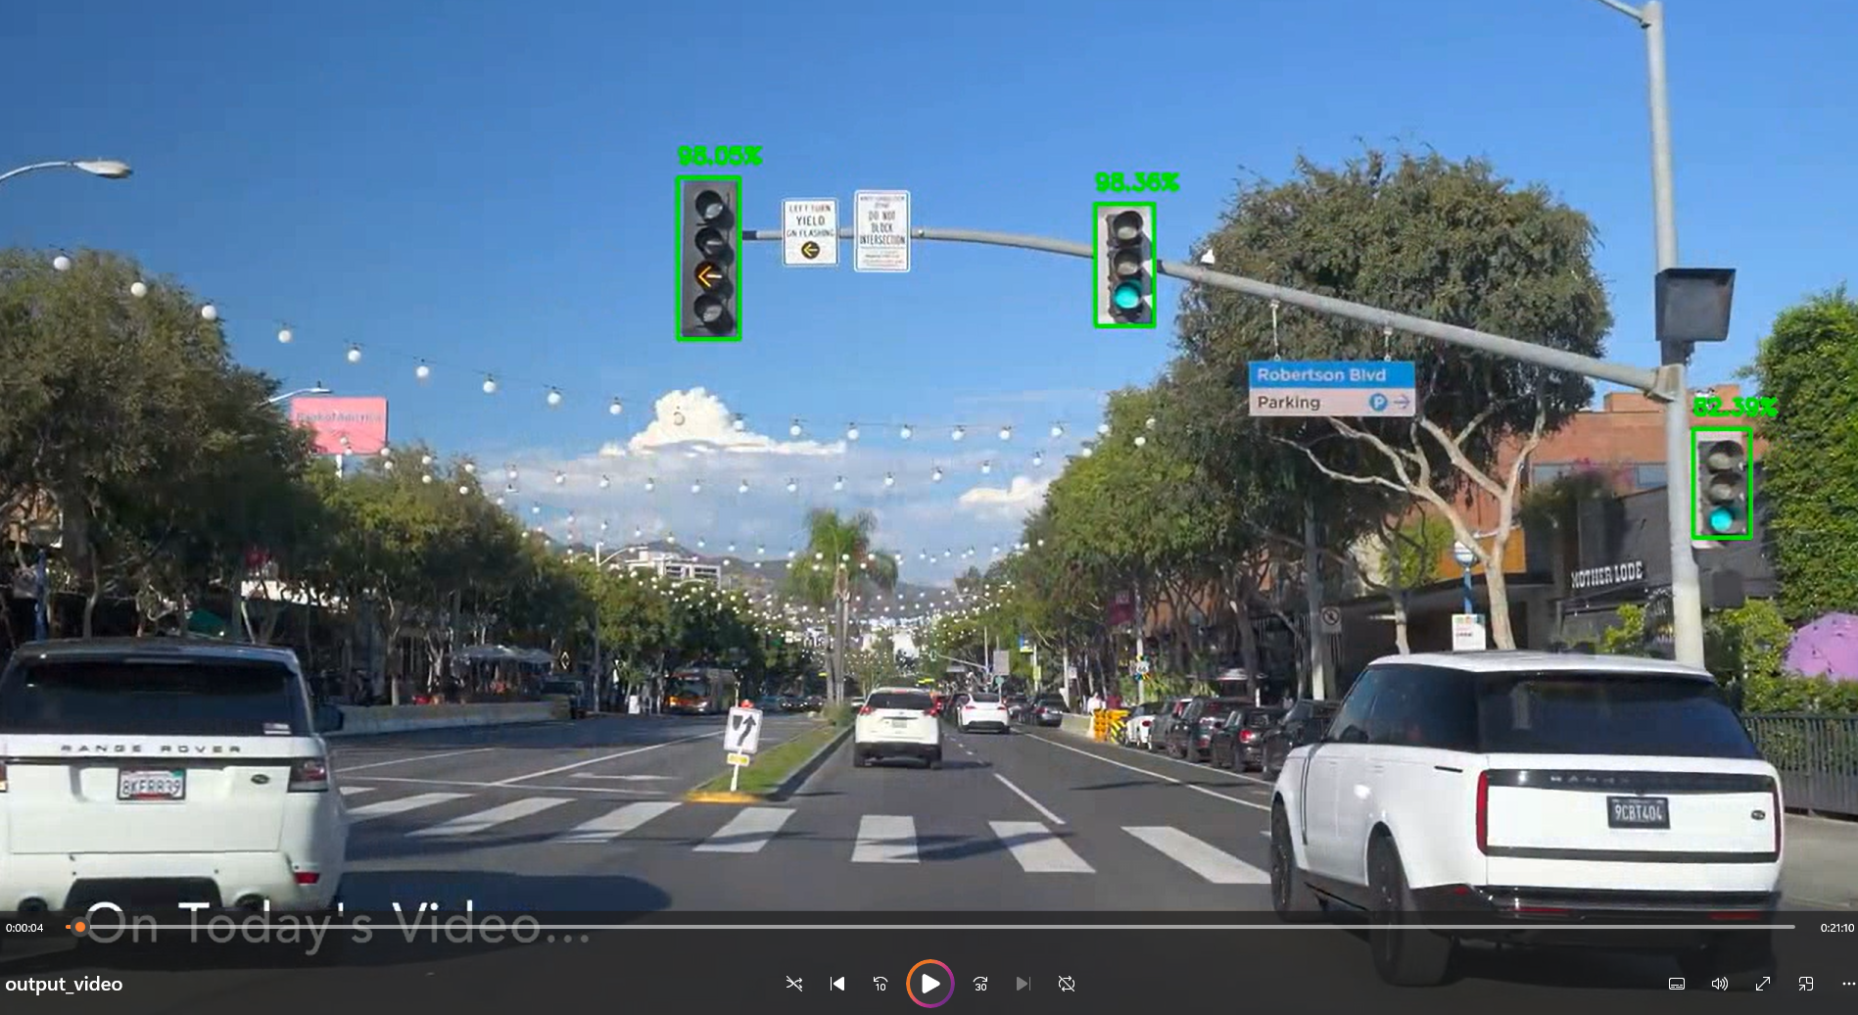

Slide 3

Goal
The primary goal of this project is to improve a driver’s situational awareness at a low cost by providing real-time alerts about nearby traffic signs, crosswalks, and speed limits using
dash-cam footage and machine learning to reduce motor vehicular accidents.

Slide 4
Introduction
Motor vehicle accidents led to ~42,795 fatalities in the U.S. in 2022.
Major causes are speeding and distractions
Auto co-pilot systems have been proven to reduce accidents but are expensive
We want to implement a co-piliot accessible and available for everyone to use

Slide 5

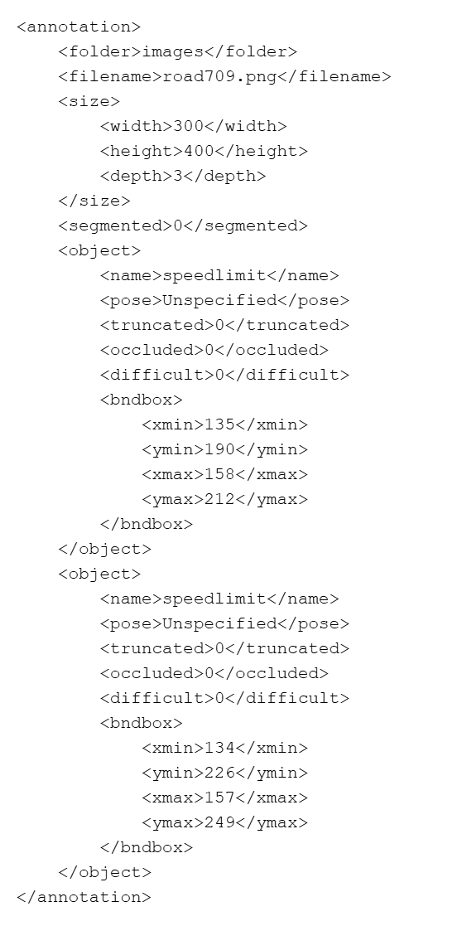
Data
877 png image
Annotations in XML
Extraction
Split 80 / 20
Classes
Stop signs
Speed limit
Traffic lights
Cross walks

Slide 6
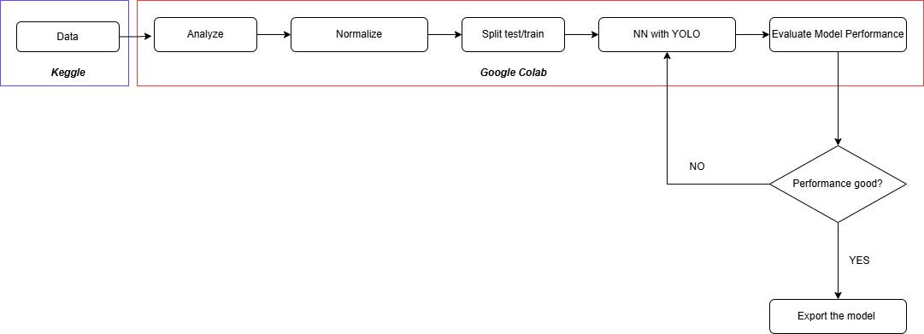
Model
Pre-trained YOLO (You Only Look Once) model, known for real-time object detection.
YOLO v11 can detect over 80 object classes.
Model starts with YOLO11 weights and updates during training
No modifications was made to the architecture of the neural network

Slide 7
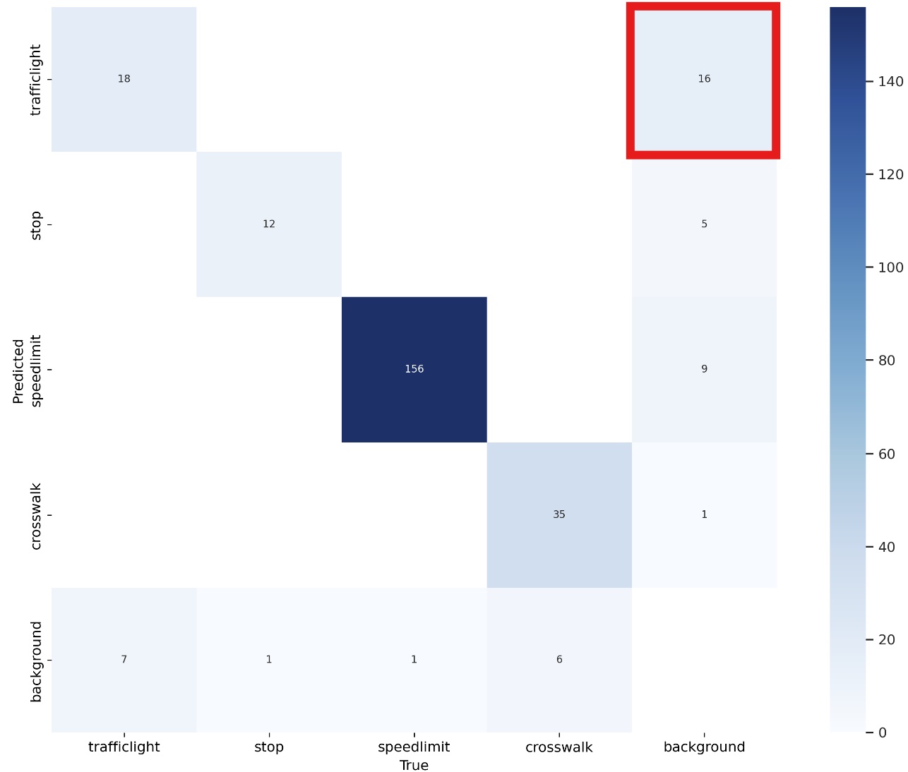
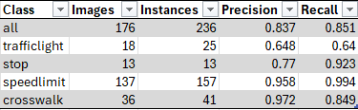
Results
Overall good performance
False Positives for traffic lights

Slide 8

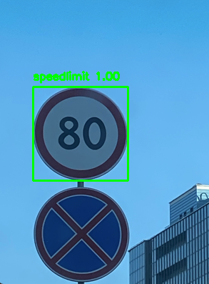
YOLO BASE WEIGHTS
YOLO NEW WEIGHTS

Slide 9
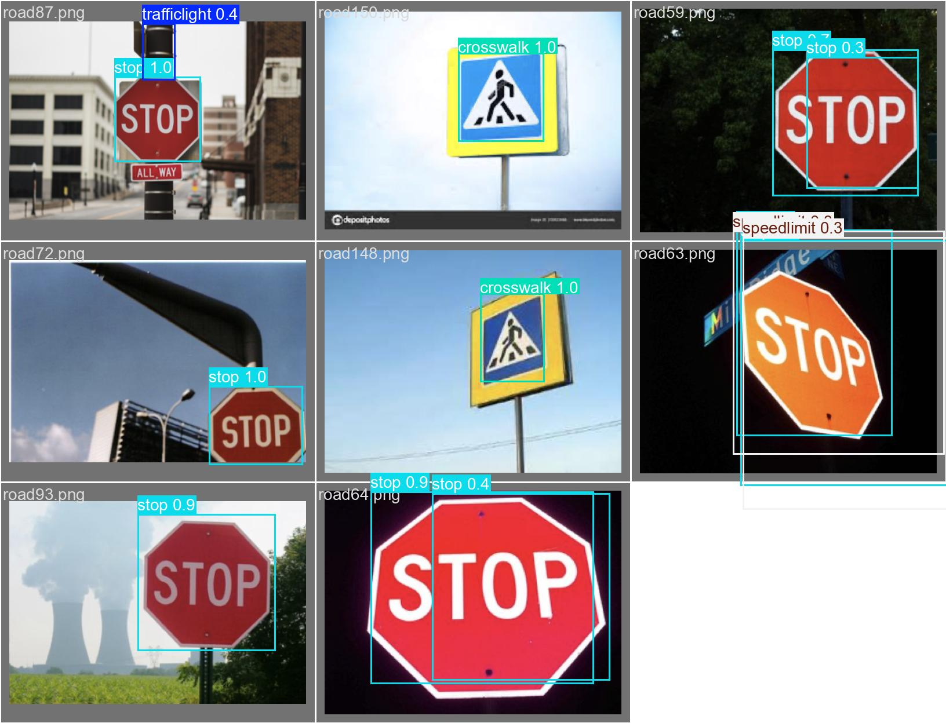

Slide 10

Conclusion
This is an affordable solution to help drives be more alert on the road
Got good performance with YOLO
Data augmentation is needed to improve dataset diversity
Investigate speed limit signs
Notes:
Explain the diagram

